Slide 1


Slide 2
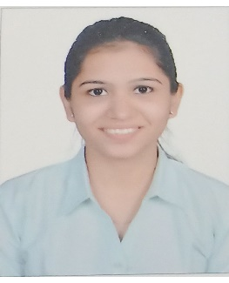
Project Highlights
Project Name : Medical Store Management System
Team Size : 1
BU Mentor Name : Mentor PS# 99002488
Team Member Details:
Shweta Melavane
PS#99002488
2009BLRICP01
B.Tech, EXTC
Time Management, Teamwork

Slide 3
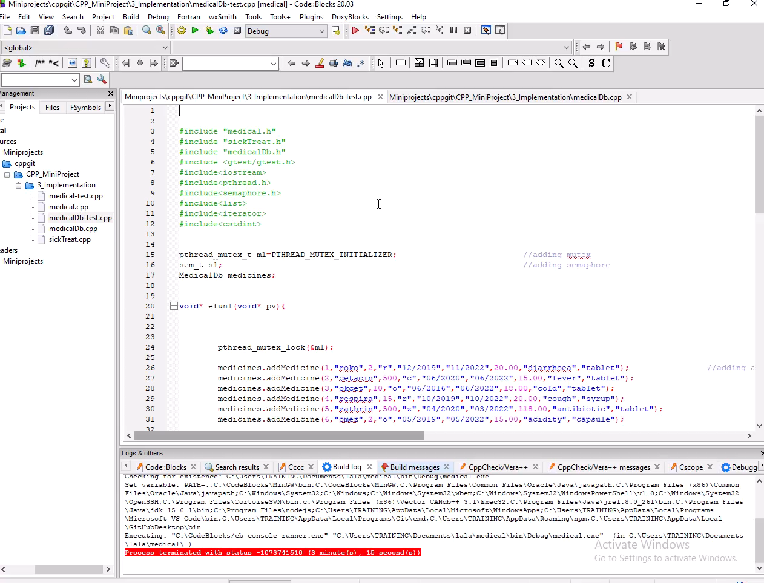
Project Video Snippet

Slide 4
Future development that can be implemented further
Supplier details can be added to the database.
Overall structure can be improved.

Slide 5

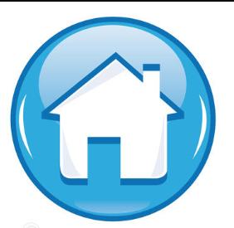
Thank You !

